Slide 1
Clean and Renewable Energy
PRESENTED BY:
KHYATI JAIN- 26317
MEGHNA RAWAT- 26320

Slide 2
Energy and Modern Society
Energy is the foundation of industrial growth, transportation, healthcare, communication, and digital infrastructure.
Rapid population growth and industrialization have significantly increased global energy demand.
Most of the current energy supply comes from fossil fuels such as coal, oil, and natural gas.
Overdependence on fossil fuels has resulted in pollution, climate change, and environmental imbalance.
Therefore, a transition toward sustainable and clean energy systems is essential.

Slide 3
Concept of Clean Energy
Clean energy refers to energy sources that produce minimal or zero pollution during electricity generation.
It does not emit harmful greenhouse gases like carbon dioxide, sulfur dioxide, and nitrogen oxides.
Clean energy improves air quality and reduces health risks associated with pollution.
It supports ecological balance and protects biodiversity.
Clean energy technologies are developed using advanced scientific principles.

Slide 4
Understanding Renewable Energy
Renewable energy is derived from natural sources that are continuously replenished.
These sources do not get exhausted with usage and are sustainable in the long term.
Renewable energy reduces dependence on imported fossil fuels.
It ensures long-term energy security for future generations.
It promotes environmentally responsible economic development.

Slide 5
Major Types of Renewable Energy
Solar energy converts sunlight into electricity using photovoltaic cells.
Wind energy generates power by converting kinetic energy of moving air into mechanical energy.
Hydropower produces electricity using flowing or falling water.
Biomass energy uses organic waste and plant material to generate fuel or electricity.
Geothermal energy utilizes heat from beneath the Earth’s surface.

Slide 6
Scientific Principles Behind Renewable Energy
Solar panels work on the photovoltaic effect where photons excite electrons in semiconductor materials.
Wind turbines operate using aerodynamic principles to rotate blades and generate electricity.
Hydropower plants convert gravitational potential energy of water into electrical energy.
Biomass energy is based on chemical energy stored through photosynthesis.
Scientific research improves efficiency and reduces cost of these technologies.

Slide 7
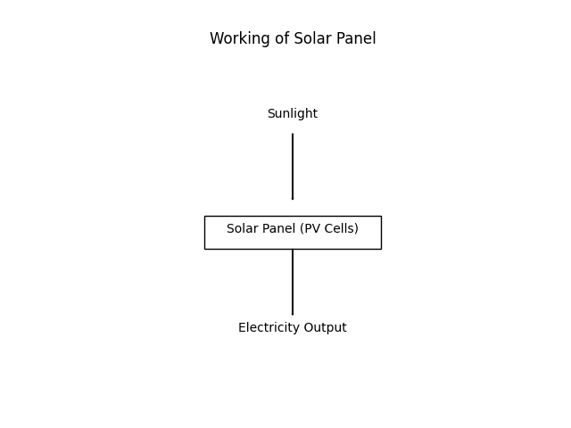
Working of Solar Panel

Slide 8
Environmental Problems Caused by Fossil Fuels
Burning fossil fuels releases large quantities of carbon dioxide, contributing to global warming.
Emission of sulfur dioxide and nitrogen oxides leads to acid rain.
Oil spills cause severe damage to marine ecosystems.
Coal mining results in land degradation and water pollution.
Continuous fossil fuel use disturbs the natural carbon cycle.

Slide 9
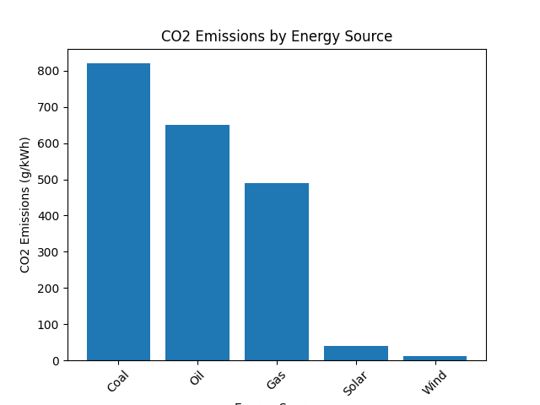
CO2 Emissions by Energy Source
Coal has the highest carbon emissions.
Oil and gas also emit large amounts of CO₂
Solar and wind produce very low emissions.
Renewable energy helps reduce global warming.

Slide 10
Renewable Energy and Global Warming
Global warming is caused by accumulation of greenhouse gases in the atmosphere.
Fossil fuels are the major source of greenhouse gas emissions.
Renewable energy sources emit negligible greenhouse gases during operation.
Adoption of renewable energy helps reduce carbon footprint.
Large-scale renewable deployment can stabilize global climate systems.

Slide 11
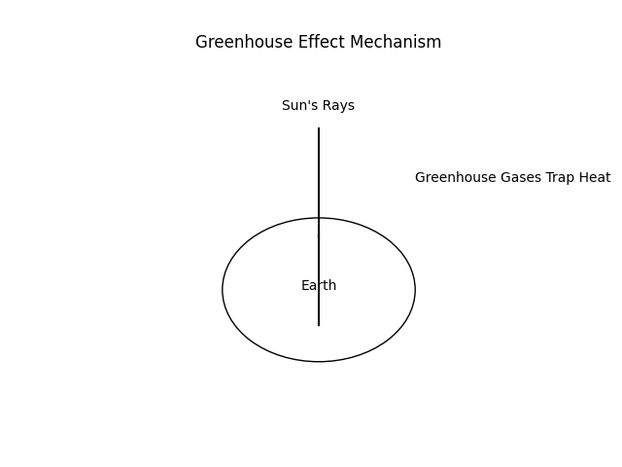
Greenhouse Effect

Slide 12
Advantages of Clean and Renewable Energy
Reduces greenhouse gas emissions and air pollution.
Provides sustainable and long-term energy supply.
Creates employment opportunities in the green energy sector.
Reduces dependence on foreign oil imports.
Supports rural electrification and improves living standards.
Promotes economic and environmental sustainability simultaneously.

Slide 13
Challenges and Limitations
High initial investment cost for installation of renewable systems.
Solar and wind energy are weather-dependent and intermittent.
Energy storage technologies are expensive and still developing.
Large land area required for solar farms and wind parks.
Need modernization of transmission and distribution infrastructure.
Requires policy support and continuous scientific innovation.

Slide 14
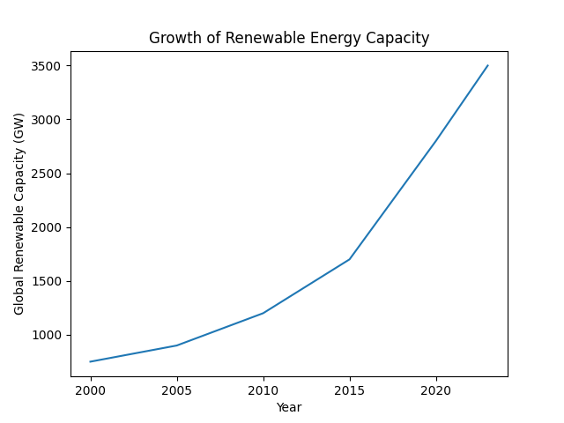
Renewable Energy Capacity Growth
Renewable capacity was low in 2000.
Growth increased gradually till 2015.
Rapid expansion after 2015.
Shows strong global shift towards clean energy.

Slide 15
Renewable Energy and Sustainable Development
Renewable energy supports economic growth without harming the environment.
It contributes to clean air and improved public health.
Promotes sustainable cities and industries.
Promotes sustainable cities and industries.
Aligns with Sustainable Development Goals related to clean energy and climate action.
Connects science, society, and environmental responsibility.

Slide 16
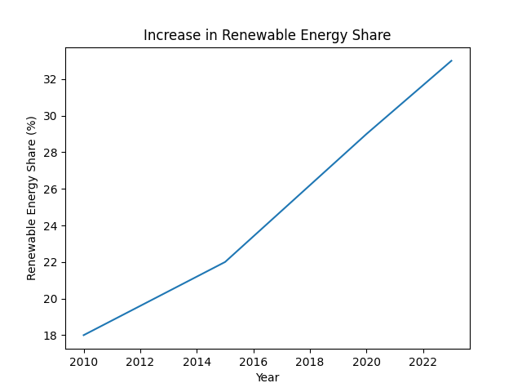
Renewable Energy Share Increase
The graph shows renewable energy share rising from 18% in 2010 to about 33% in 2023.
Growth is steady between 2010–2015.
After 2015, the increase becomes faster.
This indicates a strong global shift toward clean and sustainable energy sources.

Slide 17
PYQ-1: Role of Science in Attaining Clean and Renewable Energy Goals
Scientific research improves efficiency of solar panels and wind turbines.
Development of advanced battery storage systems ensures continuous electricity supply.
Smart grid technology allows efficient energy distribution and monitoring.
Innovation reduces production cost of renewable energy technologies.
Scientific modeling helps governments design effective energy policies.
Emerging technologies like green hydrogen and carbon capture are results of scientific advancement.
Science is the backbone of clean energy transition.

Slide 18
PYQ-2: Renewable Energy and Its Impact on Global Warming
Renewable energy replaces fossil fuel-based electricity generation.
It significantly reduces greenhouse gas emissions.
Lower carbon emissions slow the rise in global temperature.
Reduced pollution protects ecosystems and biodiversity.
Renewable adoption supports international climate agreements.
It is one of the most effective strategies to combat climate change.

Slide 19
Conclusion
Clean and renewable energy is essential for sustainable development.
Scientific innovation has made renewable technologies more efficient and affordable.
Transition from fossil fuels to renewables is necessary to reduce global warming.
Governments, scientists, industries, and citizens must work together.
Adoption of renewable energy ensures a cleaner, safer, and more secure future.

